Slide 1
Smart Cold Storage Temperature Controller Team 17: Digital Mafia
PRESENTED BY ABISHEK M V
GIRITHARAN D
NISANTH S

Slide 2
PROBLEM STATEMENT
Developing a controller that maintains safe temperature levels within a cold storage facility by activating cooling mechanisms when temperature exceeds specified limits.
Expected Features:
Temperature monitoring
Cooling activation logic
Hysteresis control
Temperature violation alert
Reset capability

Slide 3
PROPOSED SYSTEM
Project Approach: Hybrid Window FSM Multi Level Temperature Controller
Designing a digital temperature controller using Verilog, it,
Monitors the temperature inside the cold storage continuously.
Activates cooling automatically when temperature exceeds limits.
Uses hysteresis (window control) to prevent frequent ON/OFF switching.
Supports multi-level cooling for better energy efficiency.
Generates temperature violation alerts if the temperature exceeds a critical threshold.
Provides a reset capability to clear alerts and return the system to normal monitoring.

Slide 4
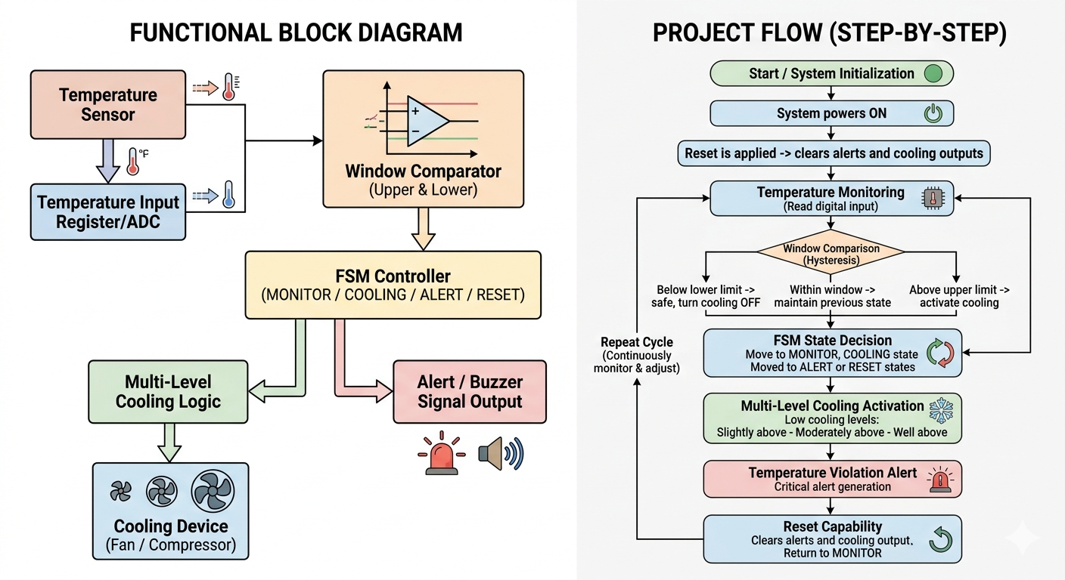

Slide 5
RTL CODING
1. window.v
2. fsm.v
`timescale 1ns / 1ps module window( input [7:0] temp, output reg below_lower, output reg above_upper, output reg critical ); parameter LOWER_LIMIT = 8'd18; parameter UPPER_LIMIT = 8'd25; parameter CRITICAL_LIMIT = 8'd35; always @(*) begin below_lower = 0; above_upper = 0; critical = 0; if(temp < LOWER_LIMIT) below_lower = 1; else if(temp > UPPER_LIMIT) above_upper = 1; if(temp > CRITICAL_LIMIT) critical = 1; end endmodule
`timescale 1ns / 1ps module fsm( input clk, input reset, input below_lower, input above_upper, input critical, output reg [1:0] state ); parameter MONITOR = 2'b00; parameter COOLING = 2'b01; parameter ALERT = 2'b10; reg [1:0] next_state; always @(posedge clk or posedge reset) begin if(reset) state <= MONITOR; else state <= next_state; end always @(*) begin case(state) MONITOR: begin if(above_upper) next_state = COOLING; else next_state = MONITOR; end COOLING: begin if(critical) next_state = ALERT; else if(below_lower) next_state = MONITOR; else next_state = COOLING; end
ALERT: begin if(reset) next_state = MONITOR; else next_state = ALERT; end default: next_state = MONITOR; endcase end endmodule

Slide 6
RTL CODING(cont) and SIMULATION
4. topmodule.v
testbench.v
3. monitoring.v
`timescale 1ns / 1ps module multicooling( input [7:0] temp, input [1:0] state, output reg [1:0] cooling_level ); parameter MONITOR = 2'b00; parameter COOLING = 2'b01; parameter ALERT = 2'b10; always @(*) begin cooling_level = 2'b00; case(state) MONITOR: cooling_level = 2'b00; COOLING: begin if(temp >= 25 && temp < 28) cooling_level = 2'b01; else if(temp >= 28 && temp < 32) cooling_level = 2'b10; else if(temp >= 32) cooling_level = 2'b11; end ALERT: cooling_level = 2'b11; endcase end endmodule
`timescale 1ns / 1ps module topmodule( input clk, input reset, input [7:0] temp, output [1:0] cooling_level, output alert ); wire below_lower; wire above_upper; wire critical; wire [1:0] state; parameter ALERT = 2'b10; window w1( .temp(temp), .below_lower(below_lower), .above_upper(above_upper), .critical(critical) ); fsm f1( .clk(clk), .reset(reset), .below_lower(below_lower), .above_upper(above_upper), .critical(critical), .state(state) ); multicooling m1( .temp(temp), .state(state), .cooling_level(cooling_level) ); assign alert = (state == ALERT) & (~reset); endmodule
`timescale 1ns / 1ps module testbench; reg clk; reg reset; reg [7:0] temp; wire [1:0] cooling_level; wire alert; topmodule uut( .clk(clk), .reset(reset), .temp(temp), .cooling_level(cooling_level), .alert(alert) ); always #5 clk = ~clk; initial begin clk = 0; reset = 1; temp = 20; #10 reset = 0; #20 temp = 22; #20 temp = 26; #20 temp = 30; #20 temp = 33; #20 temp = 36; #20 reset = 1; #10 reset = 0; #20 temp = 21; #50 $finish; end endmodule

Slide 7
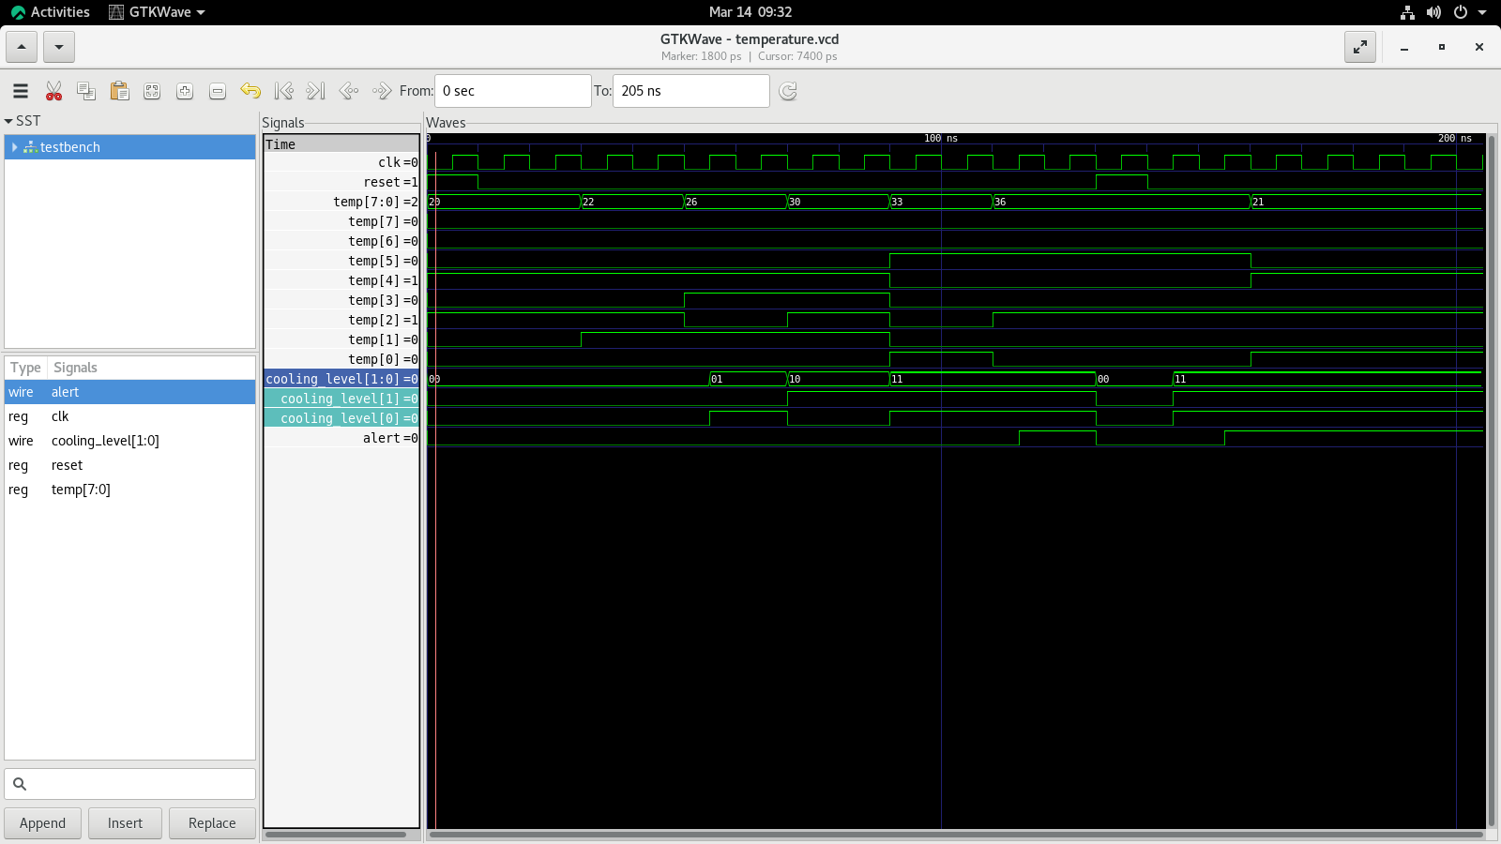
SIMULATED WAVEFORMS

Slide 8
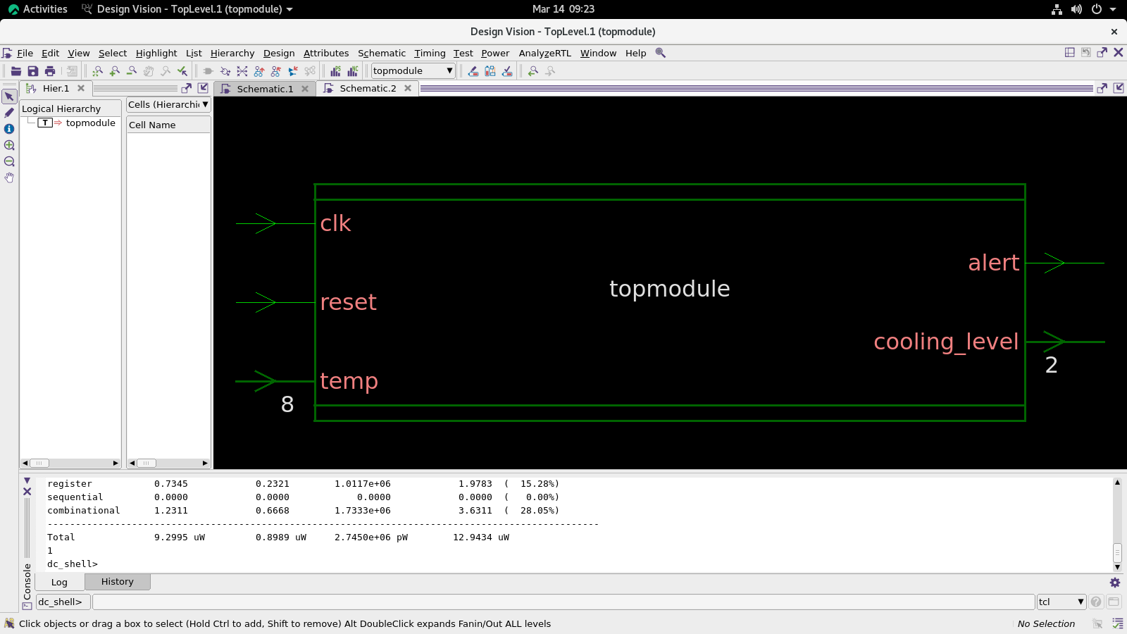
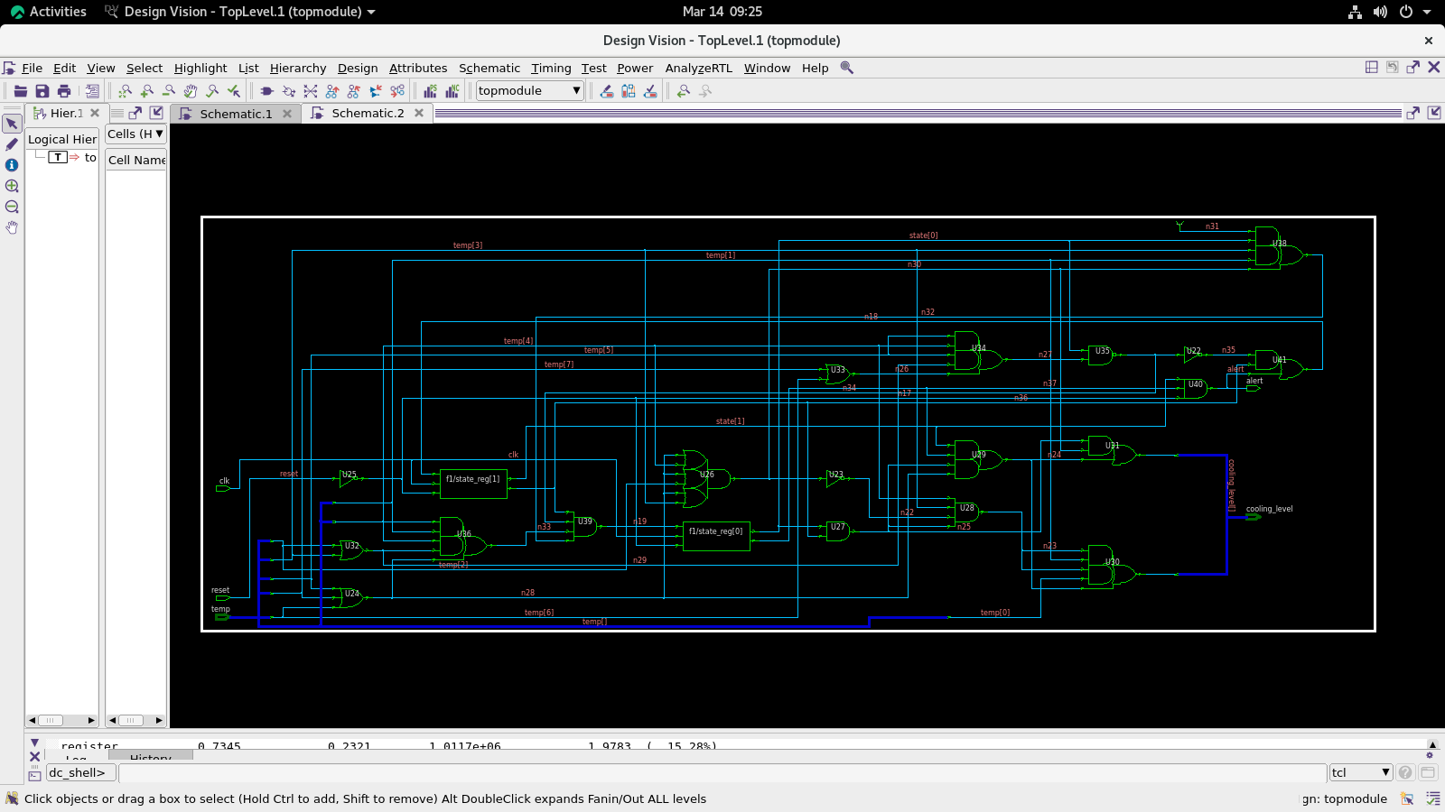
RTL SYNTHESIS
SCHEMATIC VIEW
GATE- LEVEL NETLIST

Slide 9
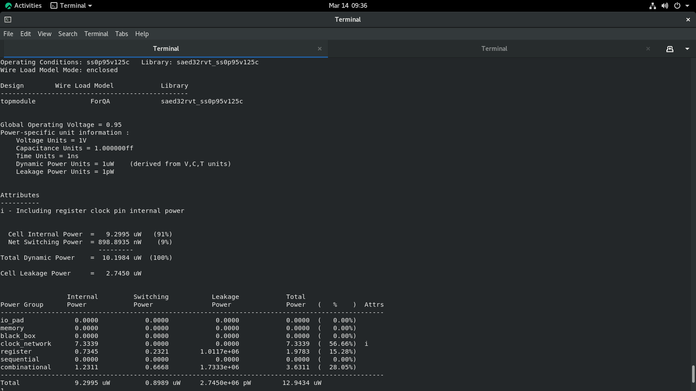
RESULTS
Results of power

Slide 10
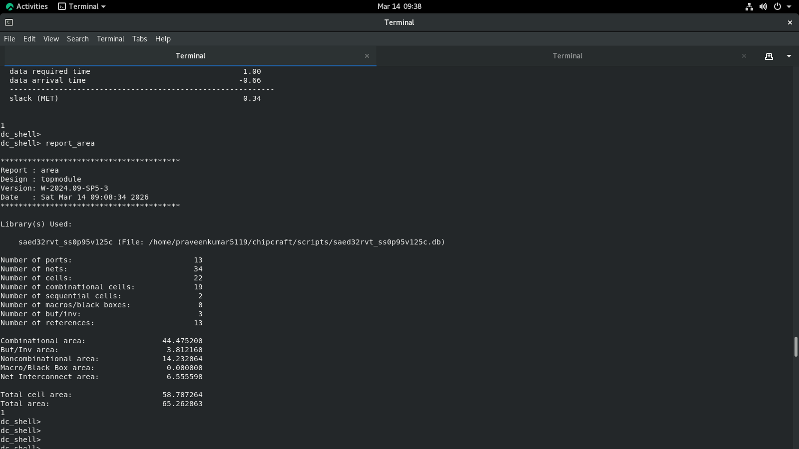
RESULTS
Results of area

Slide 11
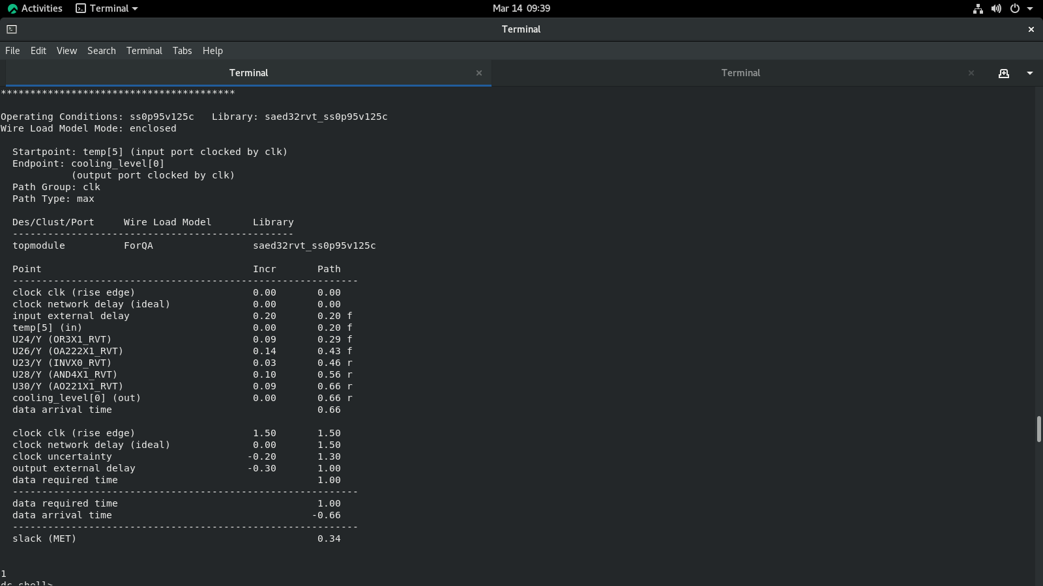
OPTIMITATION

Slide 12
CONCLUSION
In, this we overall claim that
The resultant power = 12.9434
The resultant area= 65.262863
The resultant timing SLACK(MET) = 0.34

Slide 13
THANK YOU !

